Slide 1
Social Stratification: the enduring concept that shapes the lives of Britain’s youth - Empirical analysis using the British Household Panel Survey
Roxanne Connelly, Vernon Gayle and Susan Murray,
University of Stirling
‘Stuck in the middle with whom?’ mapping out and making sense of the missing middle of youth studies
BSA Youth Study Group One Day Seminar
Friday November 4th, Imperial Wharf, London
Notes:
The sociology of youth has yet to provide an adequate explanation of youth, continuing emphasis on the problematic aspects of youth it has failed to examine the circumstances of these young people who are not seen as a problem.
The focus has frequently been on marginalised youth or successful youth. This type of analysis is theoretically unsophisticated and fails to shed sufficient analytical light on the middle ‘routine’ youth who can be described as ordinary or normal.
The challenge of the sociology of youth is to examine the processes involved in becoming adult and to locate these processes in the social structure; to combine the elements of age and class into a conceptual model which can be extended to include the other major elements of stratification, such as gender and ethnicity.

Slide 2
Aim
Demonstrate the vast amount of information available on Britain’s Youth in the British Household Panel Survey (e.g. education).
Show the extent to which social stratification and gender influence the educational outcomes of British Youth.

Slide 3
Youth is a process which is defined by and rooted in the social structure
There is a long standing connection between the parental occupations or positions in the stratification structure and the educational attainment of young people.
Notes:
There is a long standing connection between parental occupations or positions in the stratification structure and the educational attainment of youth people (there are numerous studies on social stratification and education). The transition to adulthood is found to be modified according to the social circumstances of the young person involved, and the processes are differentiated according to class and gender, since these are the primary bases of social organisation in our society.
Clarke et al. (1967) there is no such thing as a youth culture standing in direct relation with the dominant culture of society. Youth subcultures are articulated to the dominant culture with their own particular parent cultures. Since classes are the most fundamental groups in modern society the major cultural forms will be ‘class structures’. Youth subcultures therefore co-exist within the culture of the class from which they spring.

Slide 4
Past Research
The effects of social origin on the educational attainment of youth has been widely studied.
The analysis indicate a fair degree of stability in the influence of social origins on the educational outcomes of young people throughout the 20th century.
Notes:
The effects of children’s social origins on their educational attainment have been extensively investigated by sociologists and other social scientists. That such effects are important is unquestioned.
A pioneering collection of papers edited by Shavit and Blossfeld (1993) indicated that in eleven out of thirteen advanced societies, inequalities in children’s educational attainment associated with their social origins remained essentially unaltered across cohorts born in the first half of the twentieth century. However, a number of subsequent studies, including some societies contested these results.
Breen et al. (2009, 2010) report generally weakening effects of social origins on the educational attainment of children born in the first two-thirds of the last century. But, once again, a clear consensus has proved difficult to establish.
Other recent research relating to European societies on covered in Breen et al.’s work has been more supportive of the idea that educational inequalities persist or that all events show only trendless fluctuation in their level (e.g. Nordli Hansen 2008, Saar 2010, Bukodi and Goldthorpe 2010).

Slide 5
British Household Panel Survey
1991-2008 (18 waves)
5,500 households; 10,300 individuals
Nationally representative data
Notes:
The UK has been comparatively well resourced with birth cohort data. The National Survey of Health and Development (NSHD), the National Child Development Study (NCDS) and the British Cohort Study (BCS70), are birth cohorts of children born in 1946, 1958 and 1970 respectively, and respondents continue to be surveyed well into adult life. These data sources have historically provided a rich source for youth research. They are now rather dated however, and are of diminishing utility for youth research. There was no national birth cohort data collected between 1970 and the introduction of the Millennium Cohort Study (MCS) in 2000/01.
Previously birth cohorts have been useful in providing suitable large-scale survey data with both parental and youth education measures (e.g. 1946, 1958, 1970, 2000/1).
Missing birth cohorts in the 1980s and 1990s leave us with insufficient data for these types of analysis e.e forces analysis of certain groups of youth.
Our idea is to use the nationally representative data from the British Household Panel Survey. It is not designed specifically for youth transition studies or stratification (e.g. parents occupation and filial attainment).
However, Dr Murray has recently shown that youth can be appropriately studied using this household data.
BHPS – 1991-2008 (18 years of interviews). Followed young people from when they became 16 and entered the adult survey.

Slide 6
British Household Panel Survey
Macro-Level Change
Synthetic Cohort of recent youth

Slide 7
Macro-Level Change
BHPS main sample (Wave M)
Pseudo cohorts by decade of birth
We can analyse youth outcomes based on retrospective data

Slide 8
Change over 20th Century
In the decades following the war most British young people left education at the first opportunity.
More recently rising proportions of young people remain in education.
General agreement amongst sociologists as to the backdrop against which this change took place.

Slide 9
Change over 20th Century
Collapse of the youth labour market
Decline in the number of suitable jobs for school leavers
Especially those leaving school at the minimum age
Especially the poorly qualified
Decline in the number of apprenticeships and other training opportunities
Decline in jobs in manufacturing
Resulting rise in youth unemployment
Policy
Widespread introduction of youth training programmes
Changes to young people’s entitlement to welfare benefits
e.g. unemployment and housing benefits
Expansion in further (and later on) university level education

Slide 10
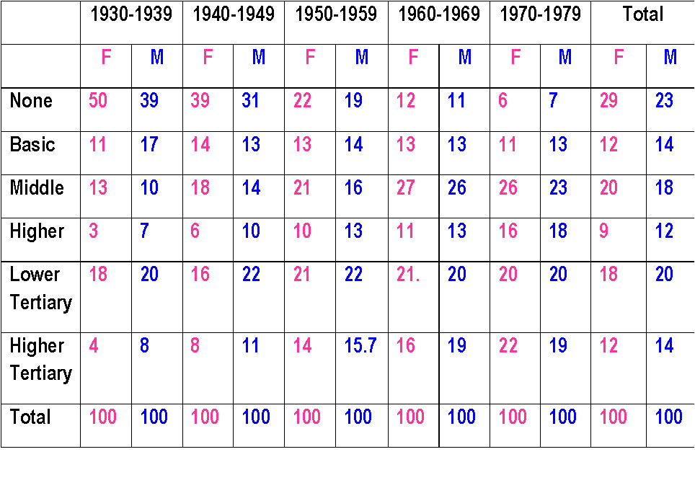
Macro-Level Change

Slide 11
Historically women have less qualifications then men. There fore we have adopted a strategy of analysing the educational outcomes of men and women separately when looking at macro-level change over time.

Slide 12
There is increased credentialisation over each decade.

Slide 13
However this pattern of credentialisation is highly gendered.

Slide 14
Gendered pattern of credentialisation

Slide 15
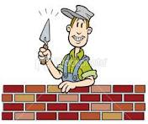
Macro-Level Change
Variables in the model:
Decade of birth (pseudo birth cohort)
Parent’s level of educational qualification
Parent’s CAMSIS score (Mean 50 SD 15)
86
40
37
32

Slide 16
Macro-Level Change Multinomial Logit Model
No Qualifications
Basic Qualifications
Middle Qualifications
Higher Qualifications
Tertiary Qualifications
Higher Tertiary Qualifications

Slide 17
Macro-Level Change Multinomial Logit Model
No Qualifications
Basic Qualifications
Middle Qualifications
Higher Qualifications
Tertiary Qualifications
Higher Tertiary Qualifications

Slide 18
Macro-Level Change Multinomial Logit Model
No Qualifications
Basic Qualifications
Middle Qualifications
Higher Qualifications
Tertiary Qualifications
Higher Tertiary Qualifications

Slide 19
Macro-Level Change Multinomial Logit Model
No Qualifications
Basic Qualifications
Middle Qualifications
Higher Qualifications
Tertiary Qualifications
Higher Tertiary Qualifications

Slide 20
Macro-Level Change Multinomial Logit Model
No Qualifications
Basic Qualifications
Middle Qualifications
Higher Qualifications
Tertiary Qualifications
Higher Tertiary Qualifications

Slide 21
Macro-Level Change Multinomial Logit Model
No Qualifications
Basic Qualifications
Middle Qualifications
Higher Qualifications
Tertiary Qualifications
Higher Tertiary Qualifications

Slide 22
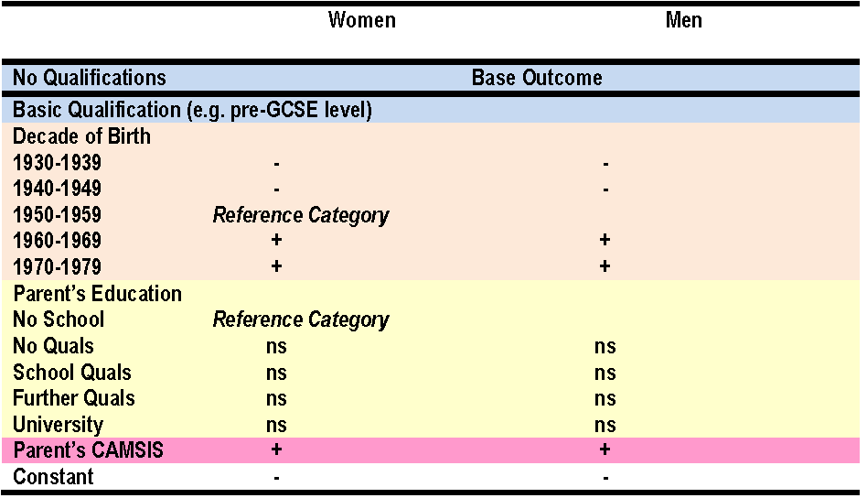
None vs. Basic
Women
Men

Slide 23
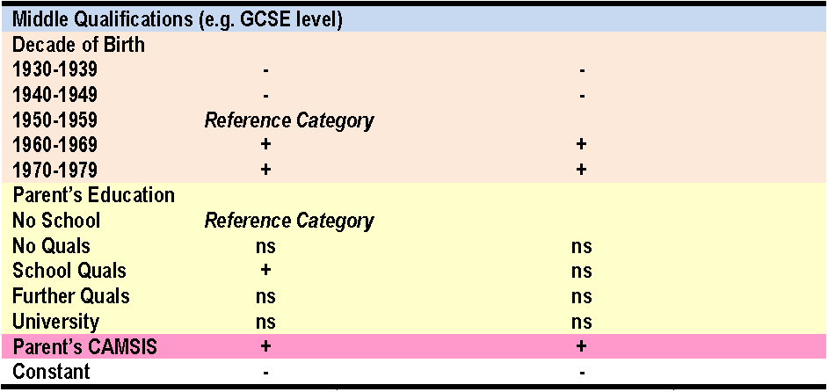
None vs. Middle (e.g. GCSE)
Women
Men

Slide 24
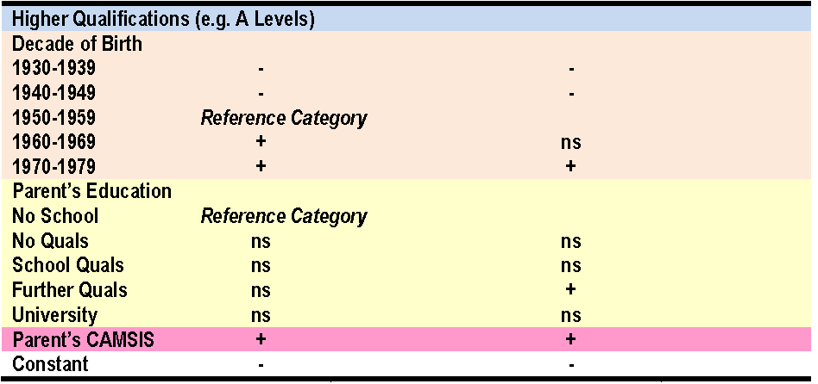
None vs. Higher (e.g. A Level)
Women
Men

Slide 25
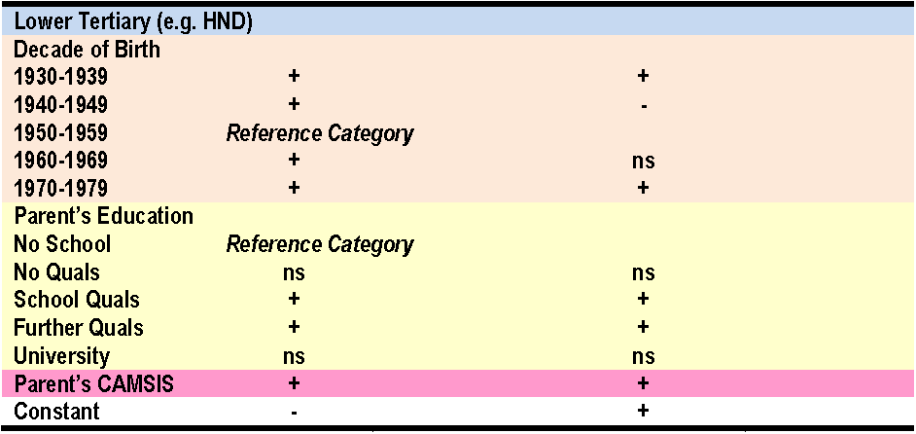
None vs. Lower Tertiary (e.g. Diploma)
Women
Men
Notes:
Heterogeneous category which is vocationally linked

Slide 26
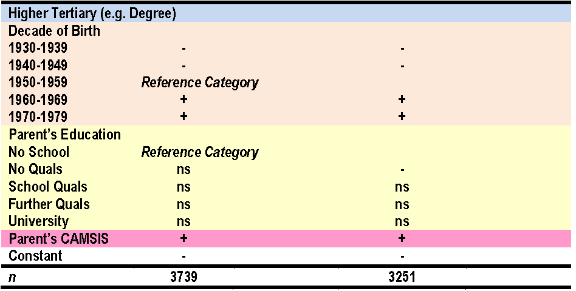
None vs. Higher Tertiary (Degree)
Women
Men

Slide 27
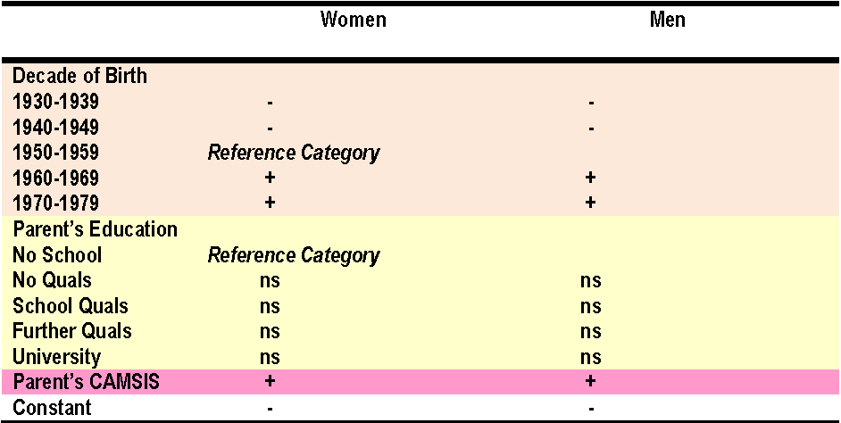
Summary

Slide 28
‘Rising 16s’ in the BHPS
These are young people in BHPS households who have ‘aged’ into the scope of the adult survey.
The design of the BHPS allows us the linkage of household level information with data on the young person.

Slide 29
Why Explore the 1990s?
Structural changes:
Collapse of youth labour market
Decline in apprenticeships
Rising in youth unemployment
Introduction of youth training
Expansion of further & university education
These changes largely took place before the 1990s.
The 1990s was a decade with educational change in the UK (e.g. The Education Reform Act 1988).
The 1990s was a decade of employment growth in the UK.

Slide 30
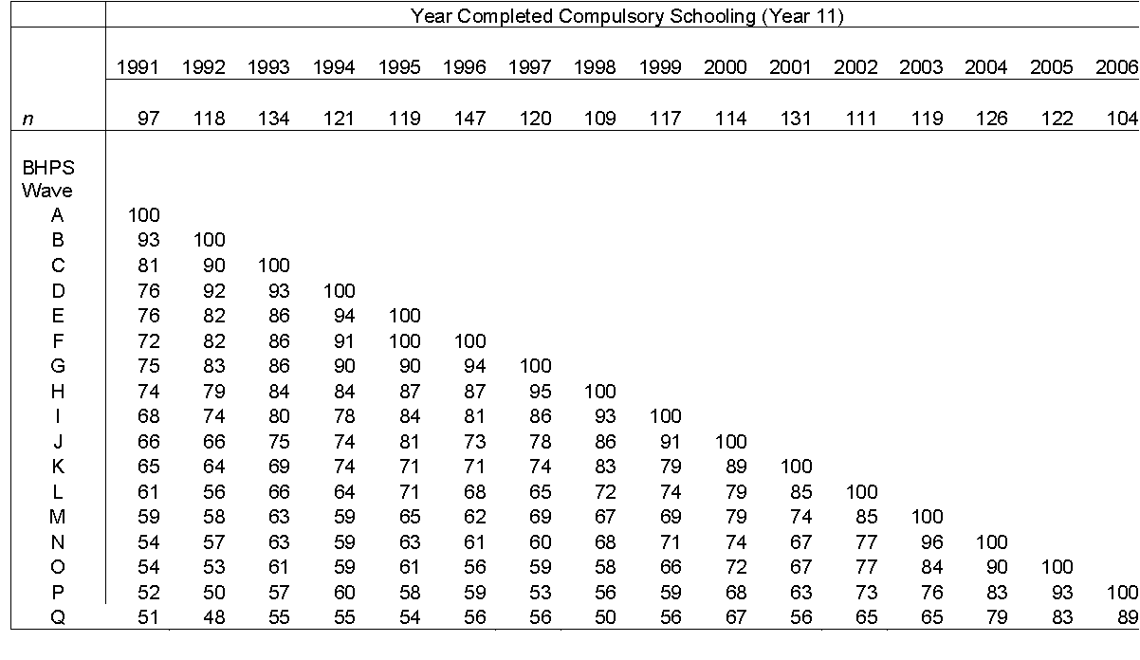
Notes:
Synthetic Cohorts of BHPS Rising 16s (Waves A –P): Original sample sizes and subsequent percentages
Respondents giving full adult interviews (BHPS Original Sample Members from the ‘Essex’ sample).
The BHPS offers a potential resource for studying the lives of young people growing up in Britain in the 1990s (Gayle 2005). The Young Person’s Survey within the BHPS, which is termed the British Youth Panel (BYP), is an obvious source of data on young people. There are a number of examples of robust empirical research based on these data (for example Brynin 1999; Bradshaw 2001; Scott 2002). However this dataset is not widely known within the British youth research community and may not yet have reached its full analytical potential.
The British Youth Panel is a variant of the standard rotating panel. A young person in a BHPS household enters the survey when they reach age 11, these new entrants are sometimes referred to as ‘rising 11s’. They leave the survey when they are old enough to enter the adult survey (age 16). A young person remains in the youth panel for a maximum of five waves. Each year the oldest group leave and enter the adult survey and a new group of eleven year olds enter the panel.
In this present paper we focus on ‘rising 16s’ in the BHPS. These are young people in BHPS households who have ‘aged’ into the scope of the adult survey. Our overall aim is to construct ‘synthetic cohorts’ of young people from BHPS households as they come to the end of compulsory education and either continue in education or move into the world of employment and other activities. The overall motivation is to explore whether or not data from the BHPS can be used to sensibly study aspects of growing up in Britain in the 1990s.
The ‘rising 16s’ here refer specifically to those young adults, answering their first (and subsequent) full adult interview, who have also been enumerated (or given a youth interview) as members of BHPS households prior to their entry into the BHPS main adult sample. This property is attractive since it allows us to collect accurate retrospective (as well as prospective) data on these young people. Accordingly, our analyses below are limited to those BHPS respondents from the ‘rising 16’ cohort which, in practical terms, means that the analysis is limited to BHPS ‘Original Sample Members’ and to members of the original BHPS (‘Essex’) sample (for sample design terminologies, see Taylor et al., 2009).
We anticipate that the design of the BHPS will allow us to link household level information with data on the young person. The structure of the BHPS also facilitates linking information from parents which is obtained from the parents’ own adult interviews in the survey. In addition, it is plausible that the BHPS structure will also facilitate the linking of information from older siblings and from non-resident parents and step-parents. See Figure 1 below.
From the outset we are aware that the ‘synthetic cohorts’ have relatively small sample sizes. Between Wave A (1991) and Wave P (2006) 1,909 young people living in England and Wales grew up into the scope of the adult survey from Original (Essex) sample households. This represents about 120 young people each school year. In a first attempt to explore how reliable these data are we have restricted our focus to young people from England and Wales. This will enable us to compare results with nationally representative data.

Slide 31
Extra variables not available in standard youth studies (e.g. The Youth Cohort Study)
Household
Number of rooms
Number of bedrooms
Number of employed people in household
Number of married persons in household
Number of unemployed people in household
Number of people of working age in household
Parental
Mum attended grammar school
Mum attended secondary modern
Mum attended independent school
Mum has FE/HE qualification
Mum employed
Number of hours Mum works
Mum's age when individual is 16
Maternal grandfather's Cambridge Scale Male
Maternal grandmother's Cambridge Scale Male
Dad attended grammar school
Dad attended secondary modern
Dad attended independent school
Dad has FE/HE qualification
Number of hours Dad works
Dad's age when individual is 16
Paternal grandfather's Cambridge Scale Male
Paternal grandmother's Cambridge Scale Male

Slide 32
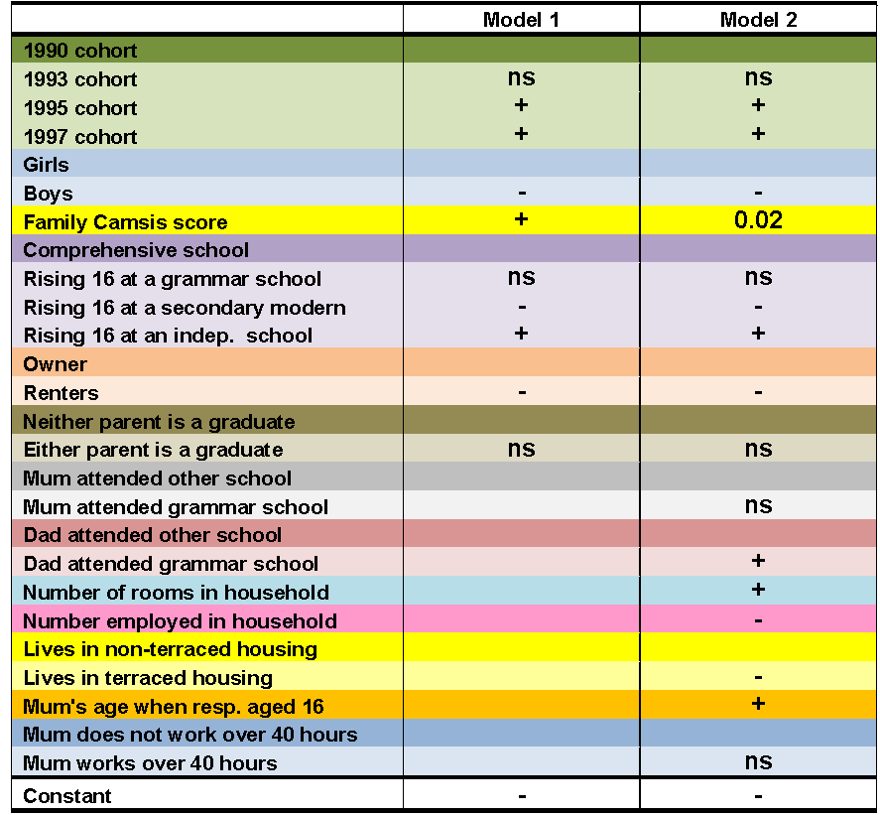
Rising 16s Achieving 5+ GCSEs (A*-C)
+
Notes:
Logistic Regression Models: BHPS Rising 16s Achieving 5+ GCSEs (A*-C)
Source: BHPS Rising 16s, England and Wales, Essex Sample Household, 1991-1999;
Model 1 Log Likelihood= -314.47; Pseudo R²=.16
Model 2 Log Likelihood= -287.20; Pseudo R²=.23
Model 1 is comparable to the results when using nationally representative data (i.e. YCS)
But can get further variables by linking with the BHPS

Slide 33
R² Model 1 = 0.16 R² Model 2 = 0.23
+
Notes:
Logistic Regression Models: BHPS Rising 16s Achieving 5+ GCSEs (A*-C)
Source: BHPS Rising 16s, England and Wales, Essex Sample Household, 1991-1999;
Model 1 Log Likelihood= -314.47; Pseudo R²=.16
Model 2 Log Likelihood= -287.20; Pseudo R²=.23
Model 1 is comparable to the results when using nationally representative data (i.e. YCS)
But can get further variables by linking with the BHPS

Slide 34
Conclusion
We agree that studies of youth have tended to focus on the two polar extremes.
By using nationally representative survey data we show that it is possible to better centralise the missing in the middle.
The BHPS can be used to compare pseudo birth cohorts (e.g. educational eras and the synthetic rising 16s cohort).
There is a wealth of household and parental information not normally available in youth studies – plus a large volume of individual data.
We show rising level of credentialisation on the educational activities of young people, gendered patterns of educational participation and the perpetual influence of parental CAMSIS.

Slide 35
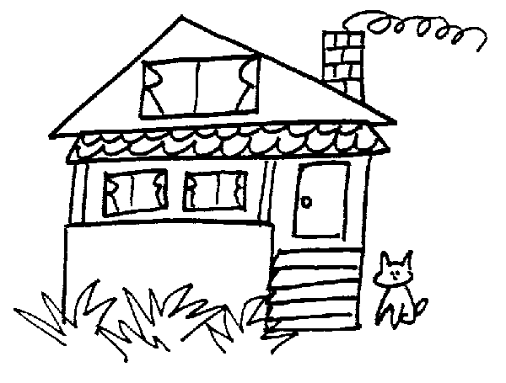
Possible BHPS data sources
Future Research Possibilities (e.g. UK Household Longitudinal Study)
Household
(resident)
Other Household
(part-time / non resident)
Parents / step parents
(co-resident)
Parents / step parents
(non-resident)
Older siblings

Slide 36
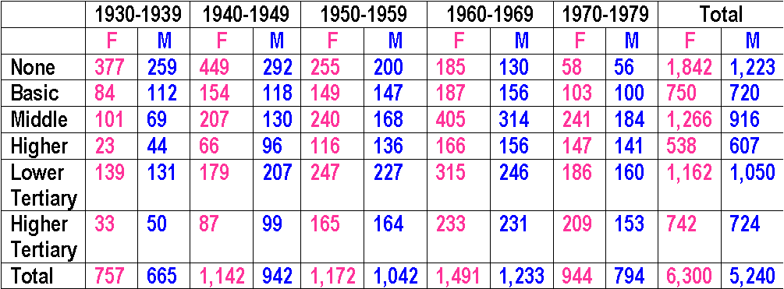
Macro-Level Change

