Slide 1
Administrative Data Quality and Measurement: A case study cross-validating UK Birth Records
Roxanne Connelly (R.Connelly@warwick.ac.uk)
Vernon Gayle (Vernon.Gayle@ed.ac.uk)

Slide 2
Aims
How consistent are maternal and paternal occupations reported on the survey and the birth records?
Are parental characteristics associated with patterns of agreement and missingness of occupational information on the survey and the birth records?
What potential impact do disagreements have on empirical sociological analyses? In order to address this we undertake an analysis of associations between cognitive test scores and parental social class comparing data from the birth records with survey data.
Notes:
The manumission in the availability of new sources of data in the early part of the twentieth century is set to revolutionise research possibilities within sociology. The emergence of ‘big data’ and other forms of ‘digital data’ offer new opportunities to study individuals and societies (see for example Burrows and Savage, 2014, Kitchin, 2014, Manovich, 2011, Schroeder, 2014). Simultaneously, advances in e-research and computer science provide increasingly improved solutions for linking large datasets (see Goerge and Lee, 2001, Halfpenny and Procter, 2015).
Administrative social science data resources contain information which originate from the operation of administrative systems, typically those that are associated with public sector agencies (Elias, 2014, Woollard, 2014). These datasets offer new opportunities for empirical sociological research. Researchers in the Nordic nations have benefited from unparalleled access to administrative social science data (see United Nations, 2007), whilst at the same time their national registers have provided the basis for a strong data structure. By contrast, in most other nations sociological analyses of administrative data have been far less widespread and are far from routine. The increased research potential that would be offered by improved access to administrative data has recently been recognised in the United Kingdom, and major infrastructural investment has been made to support the analysis of administrative data (see Administrative Data Taskforce, 2012).
See: www.adrn.ac.uk.
The new sources of administrative social science data in countries like the UK are unfolding rapidly and haphazardly, and are not supported by the framework of a national population register. The quality of these new forms of data for sociological research is yet to be established. This paper is original because it engages in an innovative analysis in order to assess the consistency of a set of administrative data using survey data collected from the same individuals. The specific focus of this paper is the assessment of the consistency of parental occupational information in UK birth records.

Slide 3
Why Parental Occupations?
Within sociology there is a longstanding recognition that in industrialised societies occupations are often the most powerful single indicator of levels of material reward, social standing and life chances (Parkin, 1971, Rose et al., 2005).
Occupations remain a key element of contemporary social life and occupation-based indicators are a cornerstone of sociological research.
Measures of parental socio-economic position are essential to analyses of inequalities in a wide range of areas for example social stratification, education, health and wellbeing (see for example Bukodi and Goldthorpe, 2012, Graham, 2007, Grätz, 2015, Sullivan et al., 2013).

Slide 4
Why Birth Records?
In the UK the only source of administrative data on parental occupations, taken at the same age for all children, are birth records.

Slide 5
Previous Studies
Shaw et al. (1990) compared parental occupations on birth certificates and in an interview in Santa Clara County, California, for the period of 1981-1983. For 71% of mothers and 80% of fathers the occupation on the birth certificate was the same as the occupation given in the interview.
Brender et al. (2008) compared parental occupations from birth certificates and from the National Birth Defects Prevention Study. For 77% of mothers and 63% of fathers the occupation on the birth certificate was the same as the occupation given in the interview.
Carucci and Prasad (1979) compared maternal occupations reported on birth certificates and in a survey in Upstate New York in 1975. They found a lack of detail in reports of maternal occupations, and 65% of mothers entered their usual occupation as housewife on the birth certificate. The survey indicated that the majority of these woman were in employment before the birth. For those occupations given there was a reasonable degree of agreement.

Slide 6
Death Certificates
Schade and Swanson (1988) argue that misclassification of occupations on death certificates mean that their utility for research is limited.
Turner et al. (1987) compared lifelong occupational histories obtained by interview to the occupations reported on death certificates in Utah. Usual occupation, defined as that with the longest duration, agreed with the death certificate occupation for 54% of the individuals. Most recent occupation agreed for 47%.
There is a tendency for informants to promote their deceased relatives to more prestigious jobs when registering deaths (Coggon 1987).

Slide 7
Colloquial ‘Evidence’
“Anyone whose registered a baby before, what happens regarding occupation? … Can I choose what is put or do they somehow decide for you?”
“Yes, you just tell them. You could say bull fighter if you wanted to.”
“I was a housewife at the time, but they said I could put down my previous occupation if I preferred... so it's not strict.”
“They write what you tell them… They don't check. You could say brain surgeon or astronaut if the registrar didn't guess you were fibbing.”
www.mumset.com

Slide 8
Administrative Data: Birth Registration Records

Slide 9
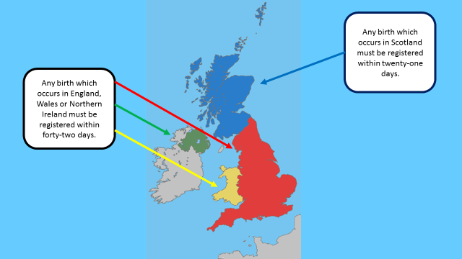

Slide 10
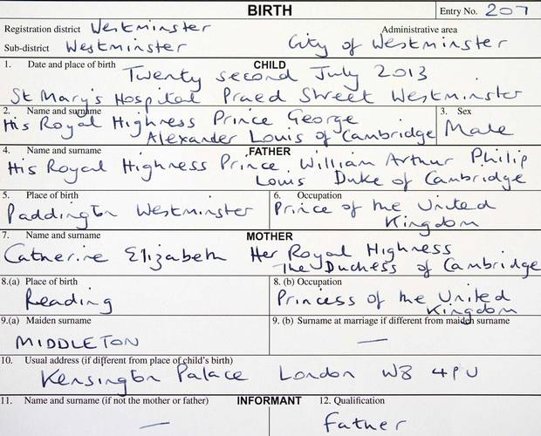

Slide 12
Guidance to Registrars
The occupation is taken as meaning the present or last full-time occupation. Account may be taken of any part-time occupation where the informant so requests.
Where persons are unemployed or unable to work through disability, the last full-time occupation should be entered. The word ‘unemployed’ should not normally be entered in the register.
Where persons have never had an occupation, a horizontal line should be entered in the appropriate space of the register.

Slide 13
Guidance to Registrars
The term ‘housewife’ is fairly frequently given by informants as an occupation. The registrar should explain that it is not an occupation in the sense of a profession, employment, business or calling and there is no requirement for it to be entered in the register, so the field should be left empty. If the person wishes to have housewife entered as their occupation the registrar should enter it in the register.

Slide 14
Survey Data: UK Millennium Cohort Study

Slide 15
UK Millennium Cohort Study
The MCS population is defined as ‘all children born between 1 September 2000 and 31 August 2001 (for England and Wales), and between 24 November 2000 and 11 January 2002 (for Scotland and Northern Ireland) alive and living in the UK at age 9 months, and eligible to receive child benefit at that age’ (Plewis 2007).
The MCS sample members were first surveyed when they were around 9 months of age.

Slide 16
Survey Questions
If currently working, has a paid job but is on leave or has worked in the past but not currently they are asked:
What is/was your (main) job?
What do/did you mainly do in your job?

Slide 17
Coding the Occupational Information
For both data sources occupational coding was carried out using computer assisted coding tools.
For both data sources verification checks were carried out on a sample of the data.

Slide 19
How consistent are maternal and paternal occupations reported on the survey and the birth records?

Slide 20
Notes:
In 29 per cent of cases a valid occupation was reported for the mother in the survey when they had missing occupational information on the birth record, this only occurred in 4 per cent of cases for father’s occupational information.

Slide 21
Notes:
Of course we do not generally use raw SOC codes for research purposes.
Translate into an occupation-based measure.
The agreement will necessarily vary according to which measure you use.

Slide 23
Notes:
An error in principle occurs when the SOC2000 codes do not match but this
does not impact on the position of the individual when the occupation is coded to a socio-economic
measure (e.g. NS-SEC).
By contrast, an error in practice occurs when the SOC2000 codes do not match and also lead to a
discrepancy in the socio-economic position which would be allocated to an individual.

Slide 24
Are parental characteristics associated with patterns of agreement and missingness of occupational information on the survey and the birth records?

Slide 28
What potential impact do disagreements have on empirical sociological analyses?

Slide 29
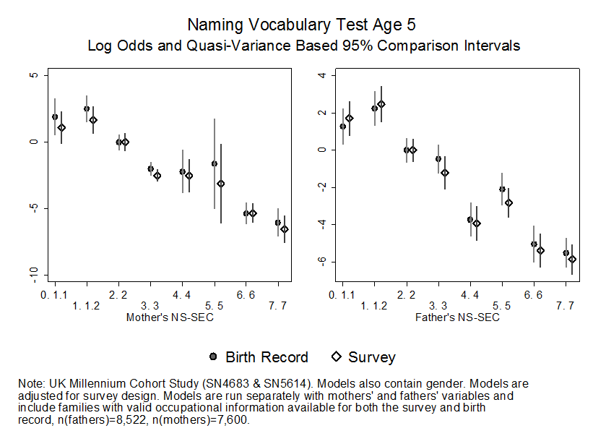
Notes:
Encouraging – but doesn’t take into account missingness
OLS Log Odd and 95% Quasi Variance Based Comparison Interval
This sensitivity analysis indicates that the same substantive conclusions would be reached for these samples regardless of whether the occupations reported in the birth records or survey are used. This is an encouraging finding, however it should be noted that these models compare only those cohort members with mothers’ and fathers’ information available in both data resources and do not take into account the patterns of missing data described above.

Slide 30
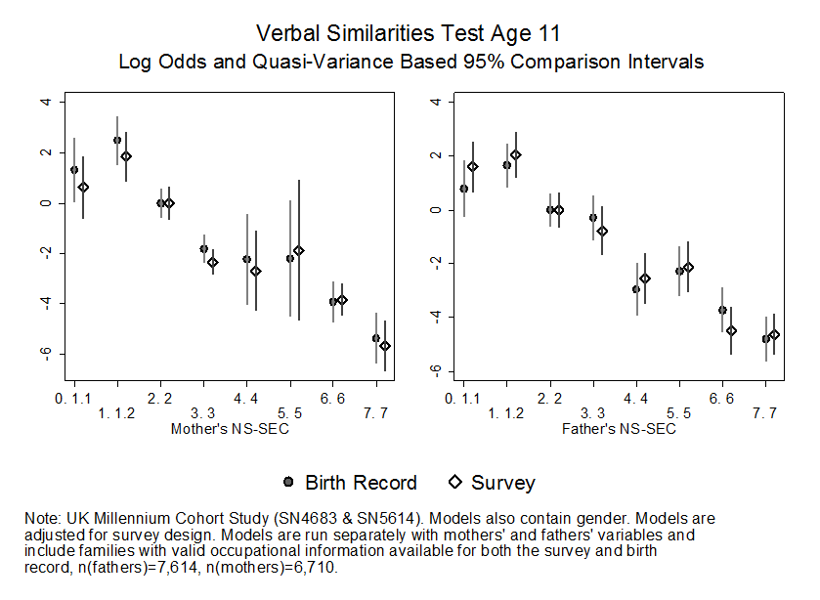
Notes:
This sensitivity analysis indicates that the same substantive conclusions would be reached for these samples regardless of whether the occupations reported in the birth records or survey are used. This is an encouraging finding, however it should be noted that these models compare only those cohort members with mothers’ and fathers’ information available in both data resources and do not take into account the patterns of missing data described above.

Slide 31
Conclusions
The empirical work undertaken in this paper is original because it assess the consistency of a set of administrative data using survey data collected from the same individuals.
A clear message from this work is that there are inconsistencies in the occupations reported in the birth records when compared with the information collected by professional interviewers shortly afterwards in the social survey.
These findings are similar to US studies which have examined errors in administrative birth records (see Brender et al., 2008, Carucci and Prasad, 1979).
This finding warns against the naive or uncritical use of UK birth records data for sociological research.
Notes:
The new forms of administrative social science data that are emerging are likely to increase the scope and scale of empirical sociological inquiries. New infrastructural resources in the UK aim to be instrumental in improving access to administrative social science data. New sources of administrative social science data are emerging rapidly. In countries like the UK administrative data are haphazard and there are no national population registers against which to organise data. Blasius and Thiessen (2012) wisely remind us that assessing the quality and comparability of data is a Herculean task. There is usually no obvious single data source that provides a stable benchmark against which the consistency of administrative data can be assessed.
The empirical work undertaken in this paper is original because it assess the consistency of a set of administrative data using survey data collected from the same individuals. Measures derived from information on parental occupations are central to a wide spectrum of sociological analyses. A clear message from this work is that there are inconsistencies in the occupations reported in the birth records when compared with the information collected by professional interviewers shortly afterwards in the social survey. These findings are similar to US studies which have examined errors in administrative birth records (see Brender et al., 2008, Carucci and Prasad, 1979). This finding warns against the naive or uncritical use of UK birth records data for sociological research.
It is fortuitous that data were available from the birth records for the participants in the Millennium Cohort Study. Ordinarily researchers using birth records data will not have access to data that acts as a benchmark or comparative source. In these circumstances researchers might reasonably be concerned about the accuracy of the administrative data. We have theorised, and subsequently demonstrated, that there are both errors in principle and errors in practice within the occupational information in the birth records data. In one illustrative empirical example we have shown that the inconsistencies in the birth records data have no appreciable influence on substantive conclusions. We strongly assert that this is not a necessarily general finding and must not be assumed a priori.
Parental occupational information at the time of a child’s birth is central for deriving other key measures that can be used in the analysis of outcomes later in the life course (e.g. family social class). Therefore we advocate that further research is undertaken into the consistency and accuracy of UK birth records data. One potential strategy would be to compare parental occupational information within the birth records with official data collected for taxation (in the case of the UK, National Insurance records could provide a potential benchmark). Another potential strategy would be to compare parental occupational information on birth records with data collected from parents in a large scale longitudinal study (for example the UK Household Longitudinal Study). A final comment is that in the changing climate of administrative social science data analysis, organisations engaged in collecting and curating information should be encouraged to place more emphasis on the providing researchers with clear information on the provenance, accuracy and consistency of the data that they collect.

Slide 32
Roxanne Connelly R.Connelly@warwick.ac.uk
@ConnellyRoxanne
Vernon Gayle Vernon.Gayle@ed.ac.uk
@profbigvern

